Slide 1

Lessons from the Jordan Inspection Reform II Project
Adit Mahmood

Slide 2
A survey of Jordanian businesses in 2011 indicated much scope to improve the inspection regime
38%
were not aware of inspection procedures, and their legal and technical obligations
63%
81%
were not informed ahead of inspection goal and purpose
were not aware of their legal rights
39%
believed that inspectors are not aware of the technical aspects of the inspection
49%
were not satisfied with the performance and conduct of the inspectors
42%
felt that they were subject to unfair penalties or decisions by inspectors

Slide 3
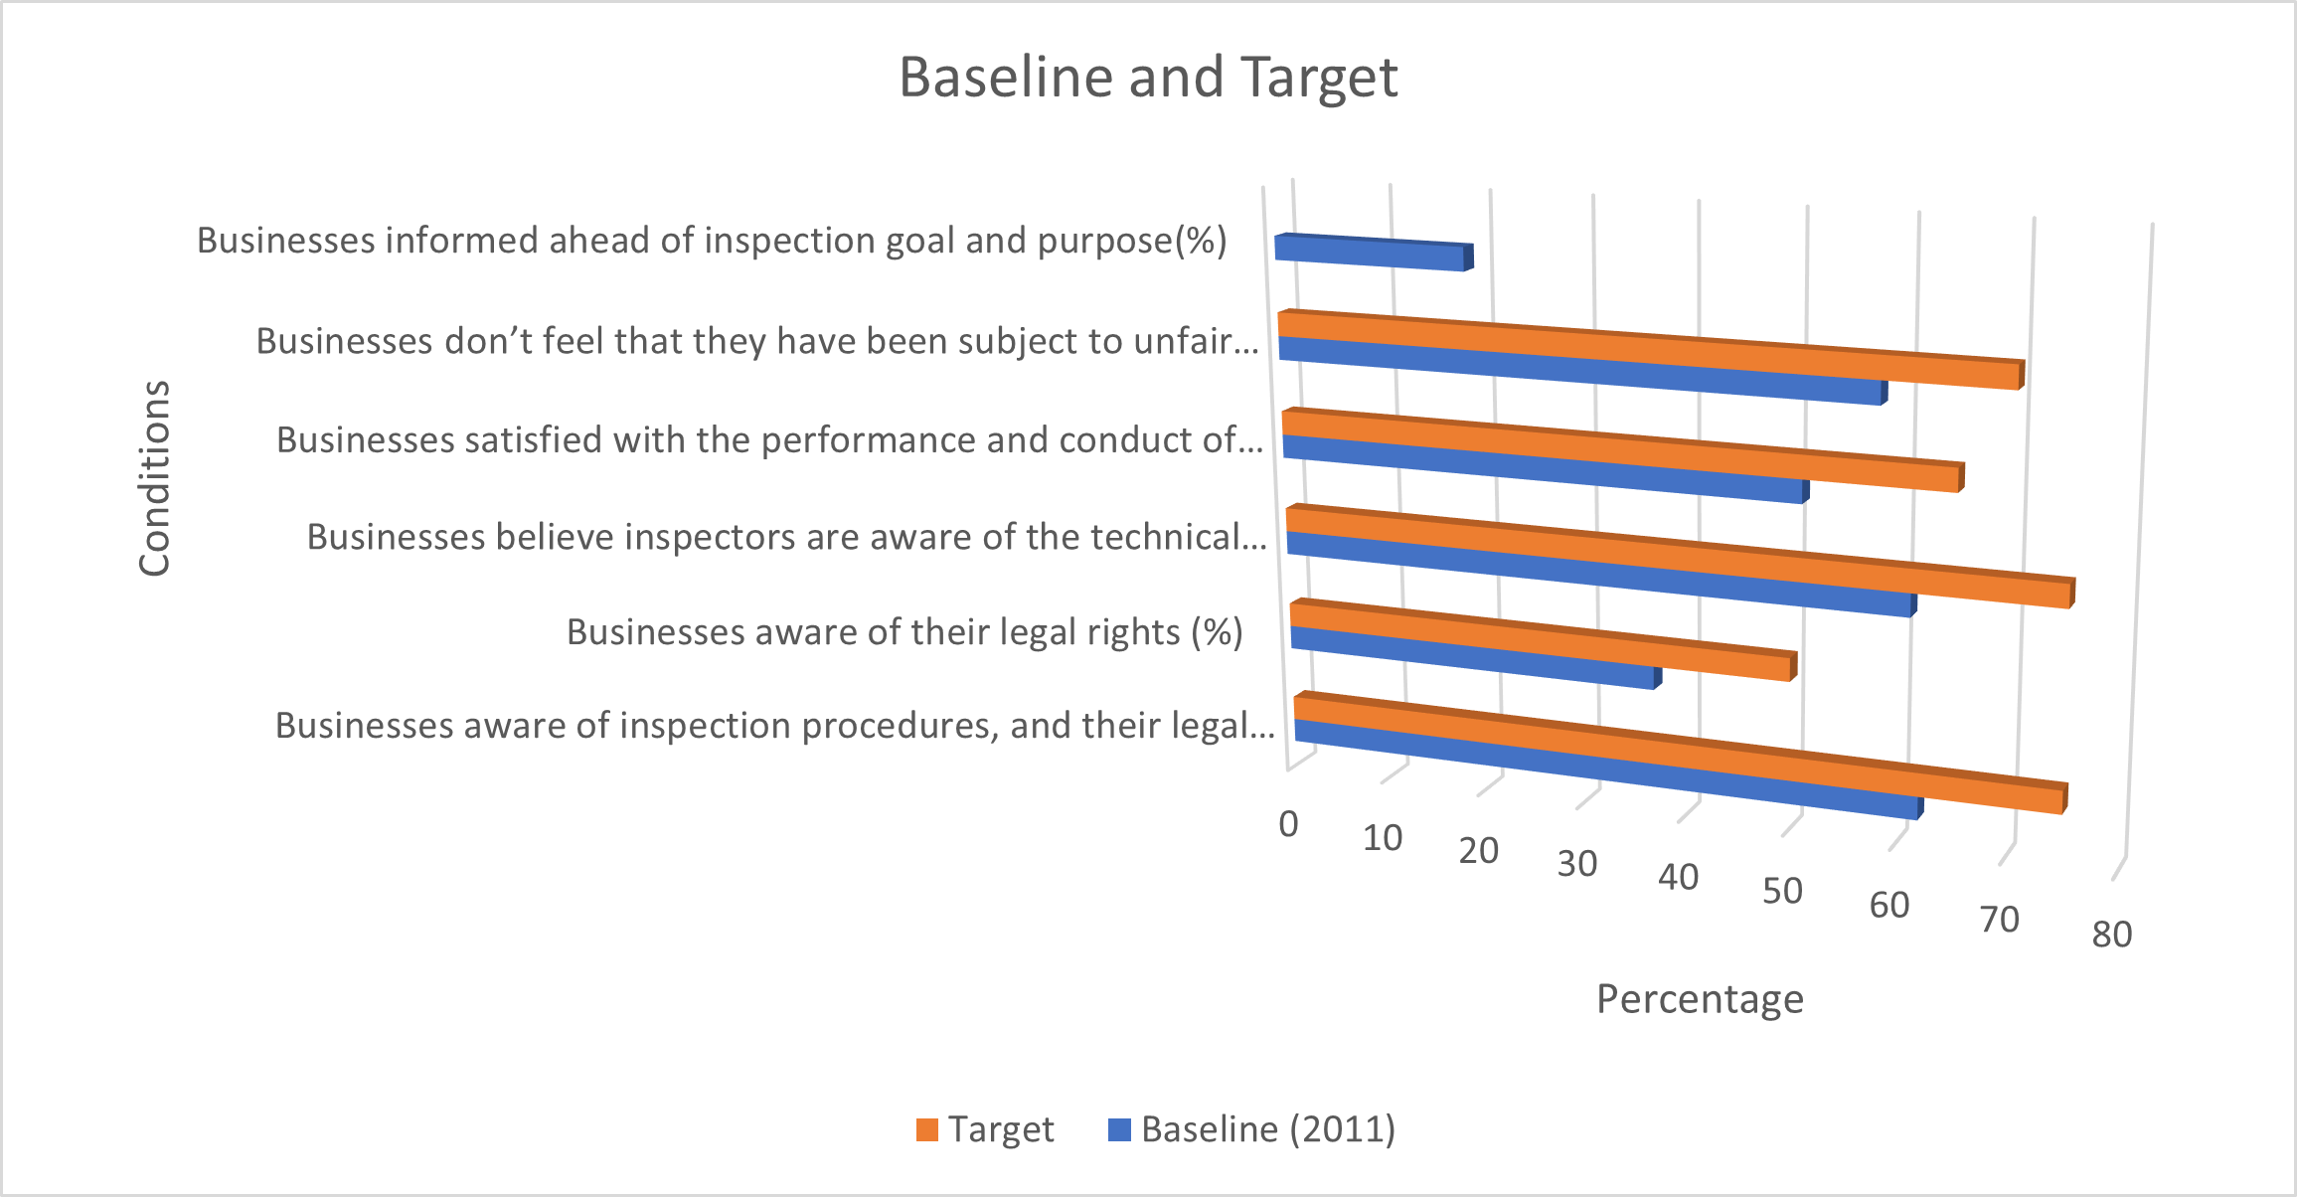
Jordanian government sought to reform the inspection system with support from IFC advisory project
IFC Inspection Reform II Project provided support in several areas:
Establish a risk assessment framework and a database on inspected businesses – to help reduce number of inspections
Document and disseminate information about legal and technical requirements for inspection – to help enhance business awareness of requirements and promote compliance
Build capacity, knowledge, and soft skills of inspectors – to improve their performance, conduct and fairness of decisions
Establish a schedule for visits and promote announced visits
Develop and adopt standard operating procedures, guidelines, and checklists
Target values were set to assess success

Slide 4
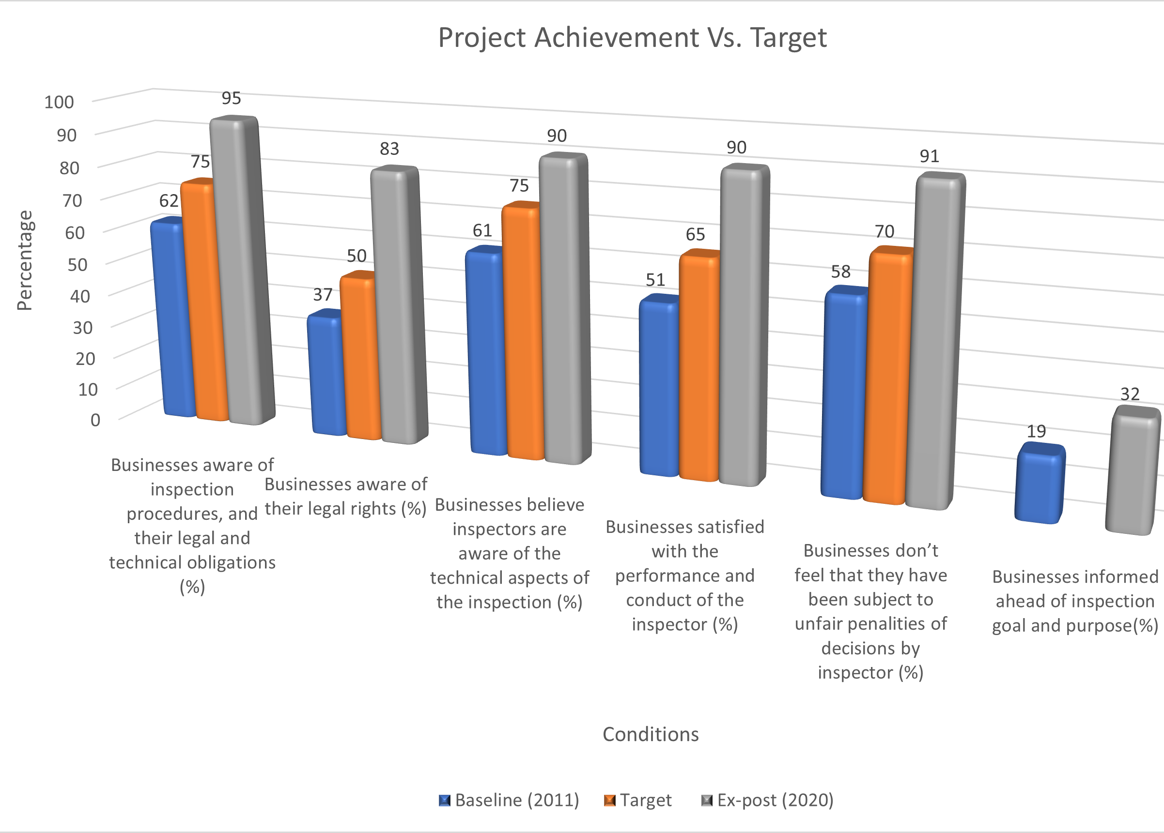
The project helped improve the inspection regime
Results exceeded baseline and target on several dimensions
However, the degree of improvement varied
Biggest improvement: % of businesses aware of their legal rights (from 37% to 83%)
Smallest improvement: % of businesses who were informed ahead of inspection goals and purpose (from 19% to 32%)

Slide 5
A study was done to identify which factors affect inspection quality: rigorous methodology was applied
Best Subset Model
The first step was to the identify the best model, i.e., the best combination of factors to use for every regression
Logistic Regression
Once the best models were chosen, logistic regression exercises were done to identify factors that significantly affected inspection quality
Prediction
The best model, implied by the logistic regression, was used to generate predictions and compare these to the actual values

Slide 6
Ex-post data were obtained from a 2020 survey of businesses: data were mostly binary or ordinal
Score Definition
1: Decline, 2: No Change, 3: Improvement
1: Yes, 0: No
Two different datasets analyzed
Study 1: analyzed responses related to the Greater Amman Municipality (GAM): these covered business opinion about the 2020 inspection related situation
Study 2: analyzed responses related to all inspectorates: these covered business opinion of changes in recent past

Slide 7
Four separate exercises done: with different datasets and different sets of variables
Study 1: GAM dataset
Study 2: Aggregate dataset
Dependent Variables
Potential Predictors
Dependent Variables
Business perception of change in inspection process over time
Business satisfaction with inspector performance and conduct
Potential Predictors
Frequency of inspection visits
Employee time spent on inspections
Business opinion on inspector awareness of technical aspects of inspections
Business awareness of their legal rights
Business awareness of inspection procedures and their obligations
Business perception of fairness of inspection decisions
Business satisfaction with inspector performance and conduct
Frequency of inspection visits
Business awareness of their legal rights
Business awareness of inspection procedures and their obligations
Inspector awareness of the technical aspects of inspections

Slide 8
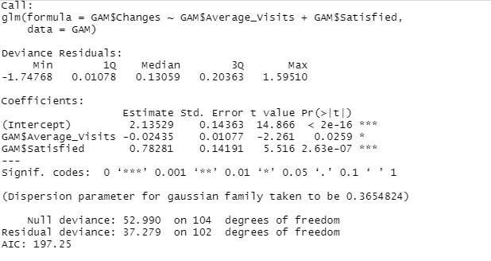
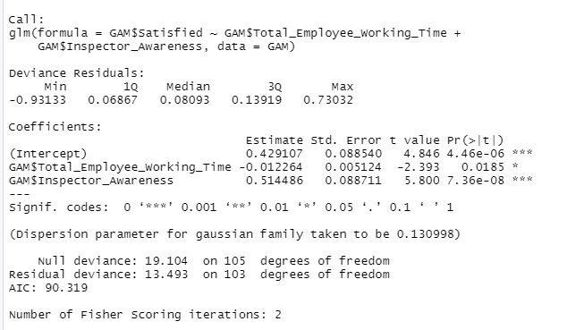
Findings of the GAM dataset analysis: inspectors’ technical knowledge and frequency of inspections affect business perceptions of inspection quality
Business perceptions about inspection quality would improve if:
more businesses are satisfied with the performance and conduct of inspectors during the inspection (very significant relationship)
inspection visits are less frequent
Businesses are more satisfied with the performance and conduct of inspectors when:
the inspectors are more aware of the technical aspects of the inspection (very significant relationship)
less employee time is spent during the inspection
Both models had high prediction accuracy

Slide 9
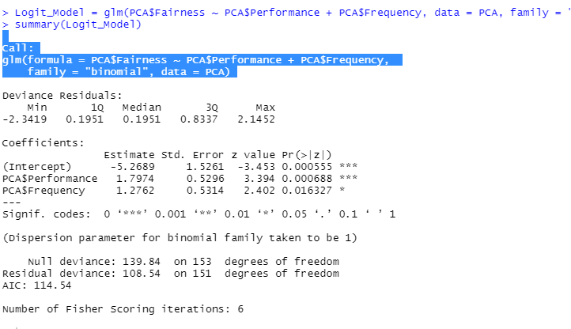
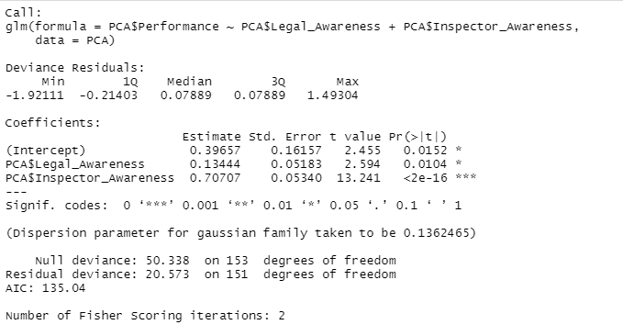
The analysis with the aggregate dataset yields findings similar to that of the GAM data set analysis
Overall business perception about fairness of inspection decisions improve when:
more businesses are satisfied with the performance and conduct of inspectors during the inspection (very significant relationship)
inspection visits are less frequent
Businesses are more satisfied with the performance and conduct of inspectors when:
the inspectors are more aware of the technical aspects of the inspection (very significant relationship)
businesses are more aware of their legal rights
The second model had high prediction accuracy

Slide 10
What affects inspection quality in Jordan? A summary of findings from the study of business responses
Reduction in total employee time spent on inspections
Increased inspector awareness of the technical aspects of inspections
Increased satisfaction of businesses with performance and conduct of inspectors
Increased business awareness of their legal rights regarding inspections
Improved business perception of quality of the inspection process
Reduction in frequency/average number of inspection visits
Increased fairness of inspection decisions

Slide 11
Where can the Jordan government focus in future? Implications of the study findings
It is clear from the analysis that more businesses would be satisfied if there was better planning and coordination between government agencies. This will reduce the duplication of visits, an issue that can have a harmful effect on inspection quality. This, in turn, will reduce the amount of employee time involved in the inspection, which appears to be a source of business frustration with the inspection process.
Programs to enhance the technical knowledge and soft skills of inspectors will help improve their performance and behavior. If inspectors can be trained and incentivized to pay more attention to this aspect, business perception of the quality and performance of the inspections would increase over time.
Programs to make businesses more aware of their legal rights will also help because it would allow them to improve the inspection process from their end.

